Slide 1
Lecture 9: Movement in discretized space

Slide 2
Goal: Unified & practical movement analysis
Conservation of numbers
Isolate movement from other demography
Calculate habitat utilization as stationary distribution
Easy to convert output to species distribution model
Identical parameters in Lagrangian and Eulerian contexts
Joint likelihood for population and individual data
Parsimonious and flexible parameterization
Use covariates to allow time-variation without extra parameters
Computational efficiency
Euler approximation and uniformization to avoid large-tailed movement
Scale-free parameters
Correct for discretization choice
Continuous-time calculation
Calculate at any intermediate time within intervals
Notes:
Fitted a spatio-temporal model using VAST with (right) or without (left) ROMS reconstruction of bottom temperature as a log-linear and log-quadratic effect on two linear predictors in a delta model. Including temperature had little effect on predictions of density, although differences are perhaps noticeable in 2016.

Slide 3
Discussion topics:
Review: Lagrangian movement
Matrix exponential
Instantaneous movement matrix
Advection-diffusion model

Slide 4
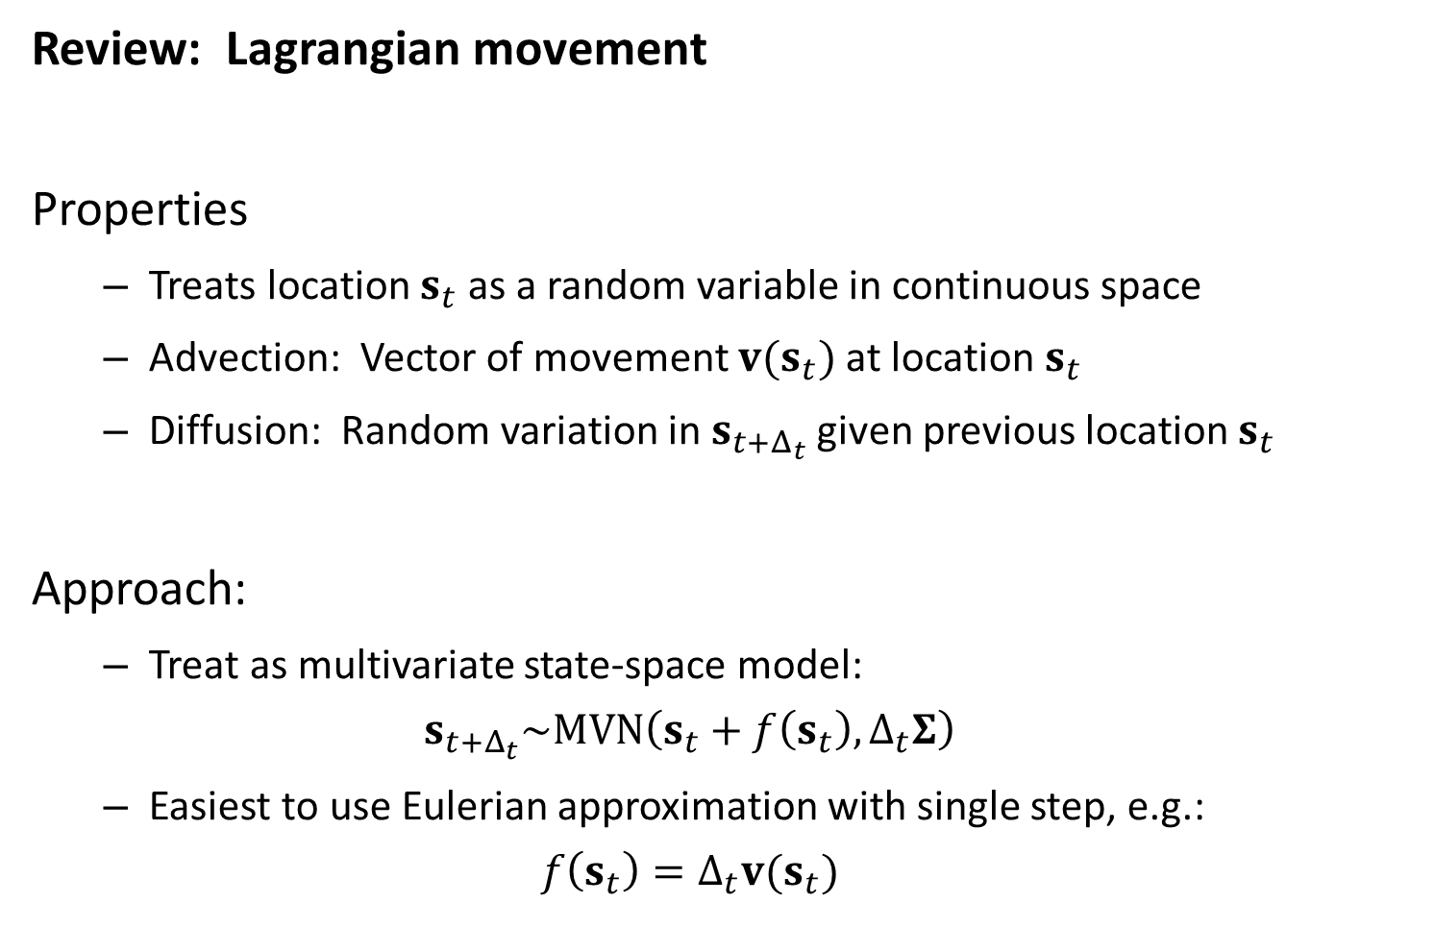
Review: Lagrangian movement
Properties
Treats location $s_{t}$ as a random variable in continuous space
Advection: Vector of movement $v(s_{t})$ at location $s_{t}$
Diffusion: Random variation in $s_{t+Δ_{t}}$ given previous location $s_{t}$
Approach:
Treat as multivariate state-space model:
$$s_{t+Δ_{t}}\sim MVN\left(s_{t}+f\left(s_{t}\right),Δ_{t}Σ\right)$$
Easiest to use Eulerian approximation with single step, e.g.:
$$f\left(s_{t}\right)=Δ_{t}v(s_{t})$$

Slide 5
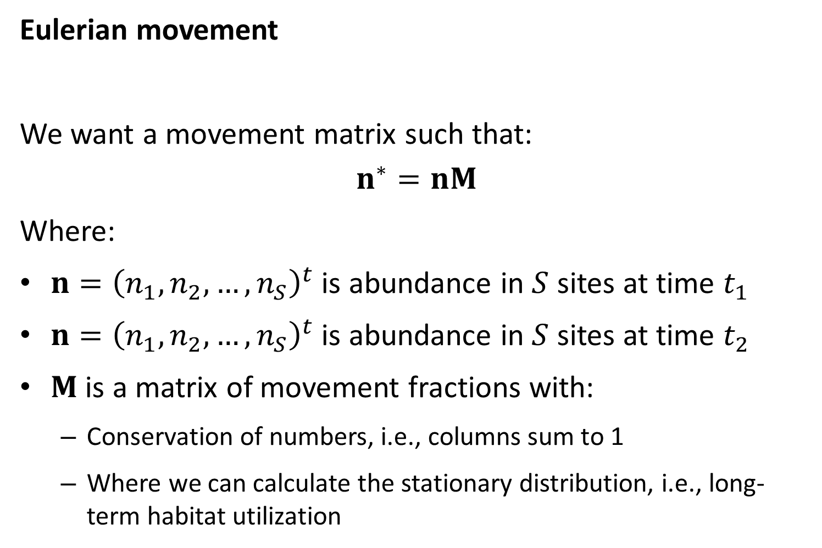
Eulerian movement
We want a movement matrix such that:
$$n^{∗}=nM$$
Where:
$n={\left(n_{1},n_{2},…,n_{S}\right)}^{t}$ is abundance in $S$ sites at time $t_{1}$
$n={\left(n_{1},n_{2},…,n_{S}\right)}^{t}$ is abundance in $S$ sites at time $t_{2}$
$M$ is a matrix of movement fractions with:
Conservation of numbers, i.e., columns sum to 1
Where we can calculate the stationary distribution, i.e., long-term habitat utilization

Slide 6
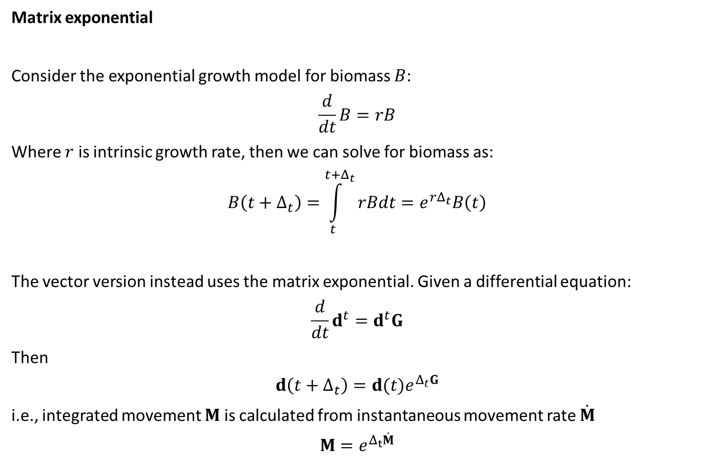
Matrix exponential
Consider the exponential growth model for biomass $B$:
$$\frac{d}{dt}B=rB$$
Where $r$ is intrinsic growth rate, then we can solve for biomass as:
$$B\left(t+Δ_{t}\right)=\int_{t}^{t+Δ_{t}}{rBdt}=e^{rΔ_{t}}B\left(t\right)$$
The vector version instead uses the matrix exponential. Given a differential equation:
$$\frac{d}{dt}d^{t}=d^{t}G$$
Then
$$d\left(t+Δ_{t}\right)=d(t)e^{Δ_{t}G}$$
i.e., integrated movement $M$ is calculated from instantaneous movement rate $\dot{M}$
$$M=e^{Δ_{t}\dot{M}}$$

Slide 7
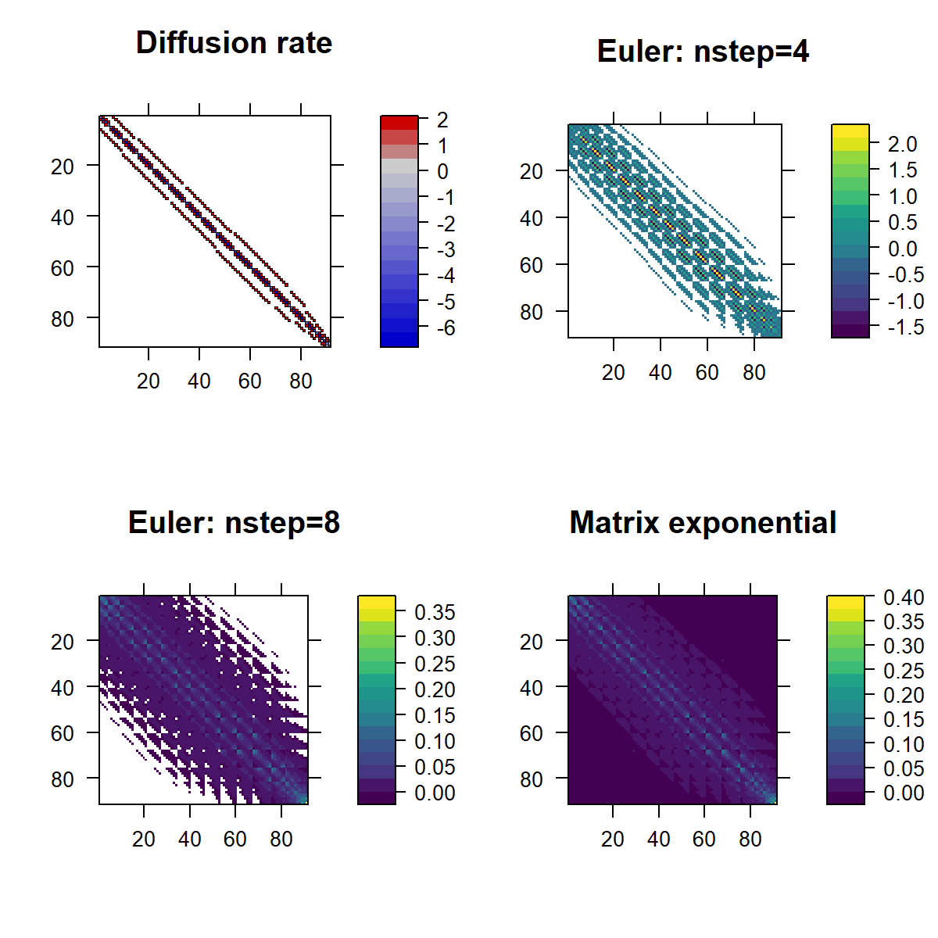
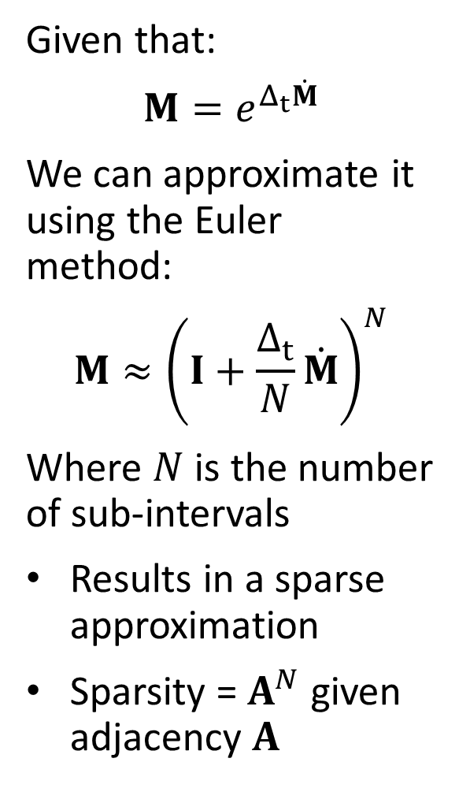
Given that:
$$M=e^{Δ_{t}\dot{M}}$$
We can approximate it using the Euler method:
$$M≈{\left(I+\frac{Δ_{t}}{N}\dot{M}\right)}^{N}$$
Where $N$ is the number of sub-intervals
Results in a sparse approximation
Sparsity = $A^{N}$ given adjacency $A$

Slide 8
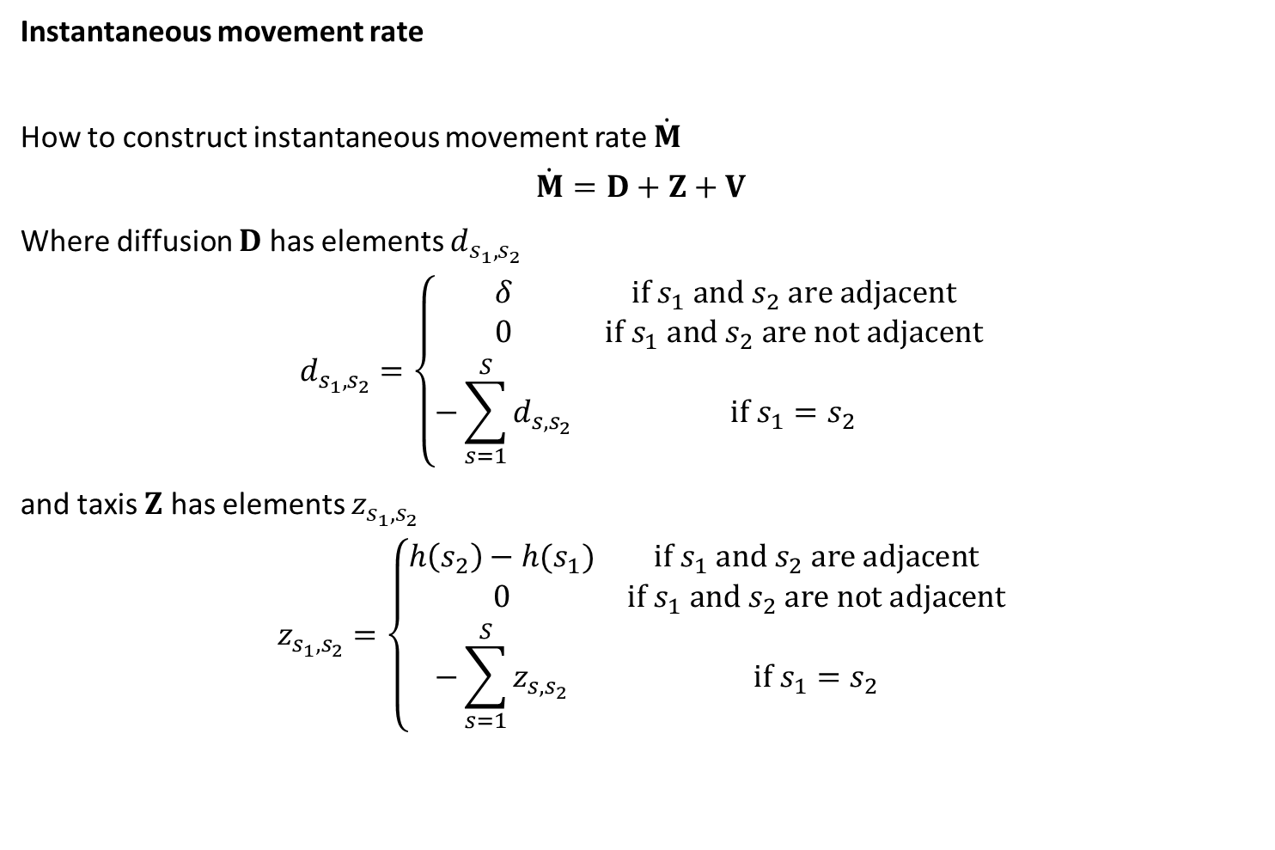
Instantaneous movement rate
How to construct instantaneous movement rate $\dot{M}$
$$\dot{M}=D+Z+V$$
Where diffusion $D$ has elements $d_{s_{1},s_{2}}$
$$d_{s_{1},s_{2}}=\left\{\begin{matrix}δ & if s_{1} and s_{2} are adjacent \\ 0 & if s_{1} and s_{2} are not adjacent \\ −\sum_{s=1}^{S}{d_{s,s_{2}}} & if{ s}_{1}=s_{2}\end{matrix}\right.$$
and taxis $Z$ has elements $z_{s_{1},s_{2}}$
$$z_{s_{1},s_{2}}=\left\{\begin{matrix}h\left(s_{2}\right)−h(s_{1}) & if s_{1} and s_{2} are adjacent \\ 0 & if s_{1} and s_{2} are not adjacent \\ −\sum_{s=1}^{S}{z_{s,s_{2}}} & if{ s}_{1}=s_{2}\end{matrix}\right.$$

Slide 9
Instantaneous movement rate
How to construct instantaneous movement rate $\dot{M}$
$$\dot{M}=D+Z+V$$
Where diffusion $D$ has elements $d_{s_{1},s_{2}}$
$$d_{s_{1},s_{2}}=\left\{\begin{matrix}δ & if s_{1} and s_{2} are adjacent \\ 0 & if s_{1} and s_{2} are not adjacent \\ −\sum_{s=1}^{S}{d_{s,s_{2}}} & if{ s}_{1}=s_{2}\end{matrix}\right.$$
and taxis $Z$ has elements $z_{s_{1},s_{2}}$
$$z_{s_{1},s_{2}}=\left\{\begin{matrix}h\left(s_{2}\right)−h(s_{1}) & if s_{1} and s_{2} are adjacent \\ 0 & if s_{1} and s_{2} are not adjacent \\ −\sum_{s=1}^{S}{z_{s,s_{2}}} & if{ s}_{1}=s_{2}\end{matrix}\right.$$

Slide 10
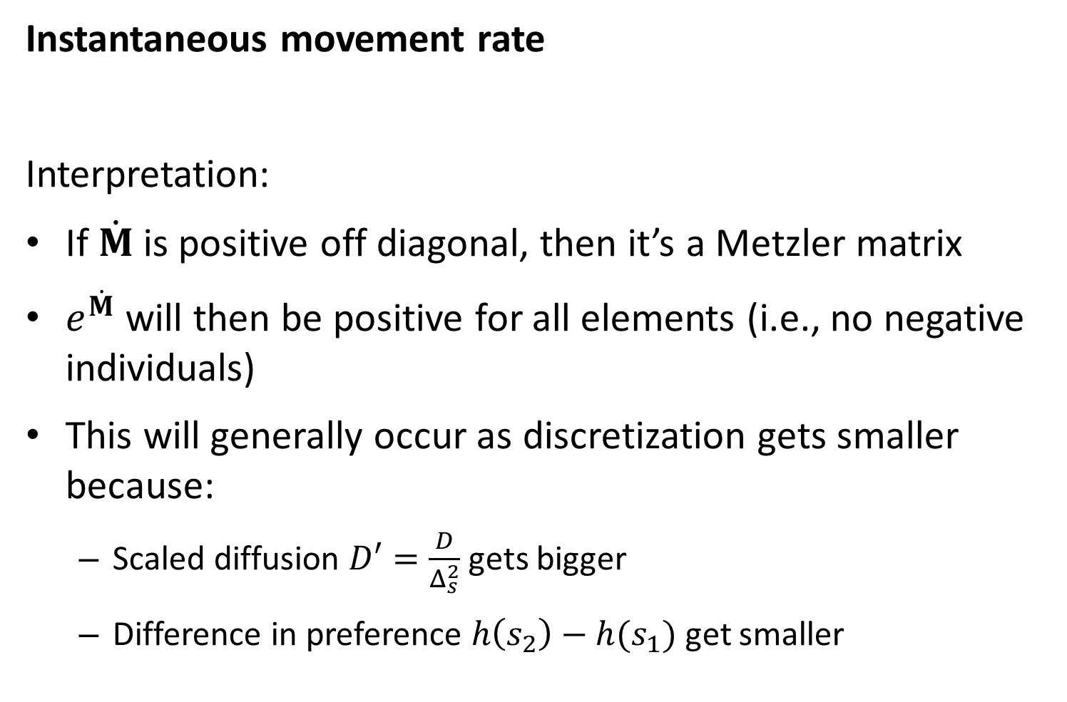
Instantaneous movement rate
Interpretation:
If $\dot{M}$ is positive off diagonal, then it’s a Metzler matrix
$e^{\dot{M}}$ will then be positive for all elements (i.e., no negative individuals)
This will generally occur as discretization gets smaller because:
Scaled diffusion $D′=\frac{D}{Δ_{s}^{2}}$ gets bigger
Difference in preference $h\left(s_{2}\right)−h(s_{1})$ get smaller

Slide 11
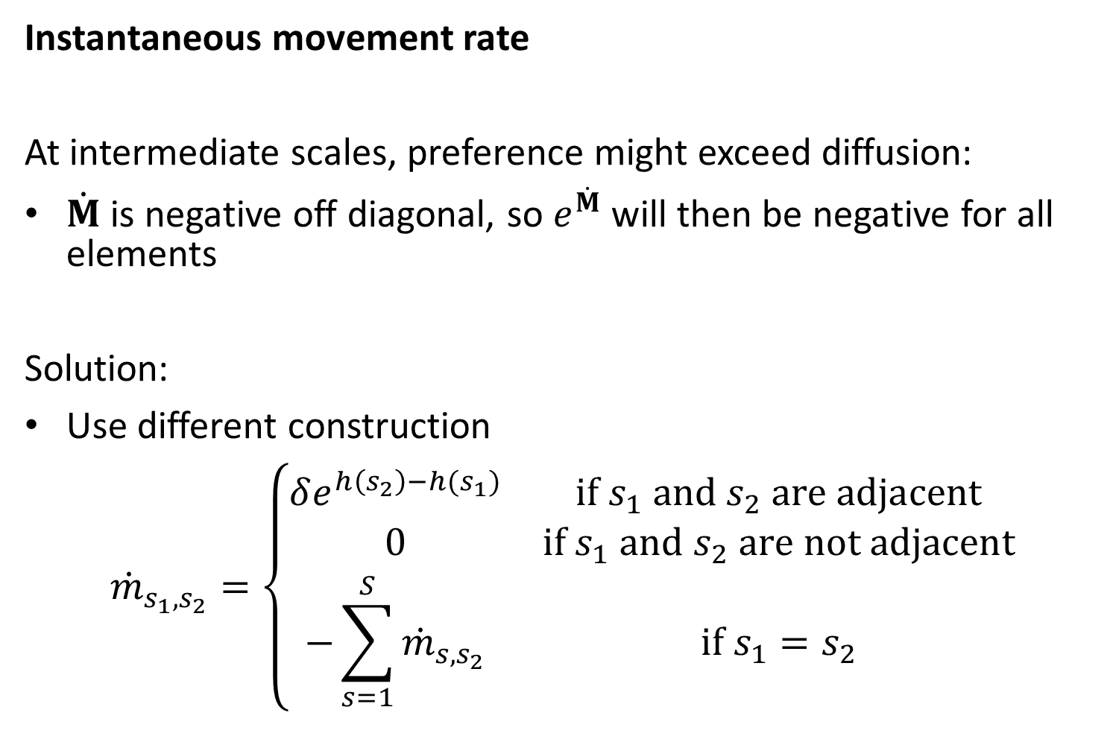
Instantaneous movement rate
At intermediate scales, preference might exceed diffusion:
$\dot{M}$ is negative off diagonal, so $e^{\dot{M}}$ will then be negative for all elements
Solution:
Use different construction
$${\dot{m}}_{s_{1},s_{2}}=\left\{\begin{matrix}δe^{h\left(s_{2}\right)−h(s_{1})} & if s_{1} and s_{2} are adjacent \\ 0 & if s_{1} and s_{2} are not adjacent \\ −\sum_{s=1}^{S}{{\dot{m}}_{s,s_{2}}} & if{ s}_{1}=s_{2}\end{matrix}\right.$$

Slide 12
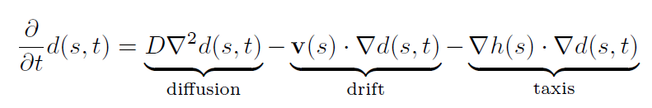
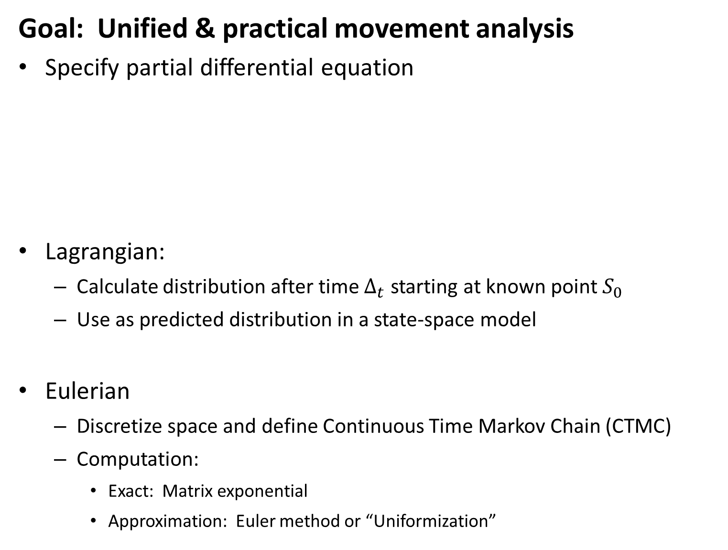
Goal: Unified & practical movement analysis
Specify partial differential equation
Lagrangian:
Calculate distribution after time $Δ_{t}$ starting at known point $S_{0}$
Use as predicted distribution in a state-space model
Eulerian
Discretize space and define Continuous Time Markov Chain (CTMC)
Computation:
Exact: Matrix exponential
Approximation: Euler method or “Uniformization”
Notes:
Fitted a spatio-temporal model using VAST with (right) or without (left) ROMS reconstruction of bottom temperature as a log-linear and log-quadratic effect on two linear predictors in a delta model. Including temperature had little effect on predictions of density, although differences are perhaps noticeable in 2016.

Slide 13
